Slide 1








Chongqing University of Technology
ATAI
Advanced Technique of Artificial Intelligence
Chongqing University of Technology
Document Modeling with Graph Attention Networks for Multi-grained Machine Reading Comprehension
ACL2020
Code : https://github.com/bozheng-hit/NQ_BERT-DM
Dataset : https://ai.google.com/research/NaturalQuestions/download
Reported by Xinsheng Wang

Slide 2

Chongqing University of Technology
ATAI
Advanced Technique of Artificial Intelligence
Chongqing University of Technology
1.Introduction
2.Method
3.Experiments
4.Conclusion

Slide 3
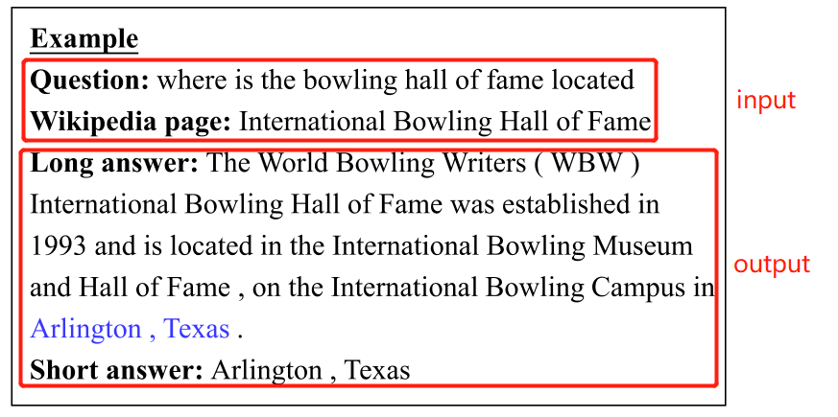
Introduction

Slide 4
Introduction
Existing methods treat these two sub-tasks individually during training while ignoring their dependencies.
The paper present a novel multi-grained machine reading comprehension framework that focuses on modeling documents at their hierarchical nature.
Notes:
现有的方法单独对待这两个子任务，忽略了二者的依赖关系。
为了解决这个问题，作者提出了一个模型…（多粒度的机器阅读理解框架）

Slide 5
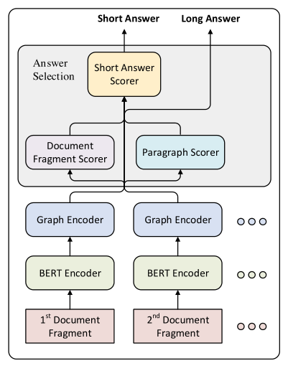

Method
Bert Encoder
the training set as a six-tuple
input is c, c=([CLS] Q [SEP] Di [SEP])
Notes:
一个训练集是一个六元组，c由文档片段内容和一个问题构成
c = ([CLS], Q1, ..., Q|Q|,[SEP], Di,1 , ..., Di,|Di|,[SEP])，且|Q| + |Di| + 3 = 512
S表示文档片段内的长答案候选集。
l∈S 是该实例的候选集合S中的目标长答案候选，即长答案标签。
s, e∈{0,1，…511}，指向目标答案区间的开始和结束，即是短答案。
t∈{0,1,2,3,4}是标注答案类型，对应5个标签。
对于包含多个短答案的实例，我们设置s和e分别指向第一个短答案的最左位置和最后一个短答案的最右位置。（短答案可以从长答案中取得）
The input is c

Slide 6
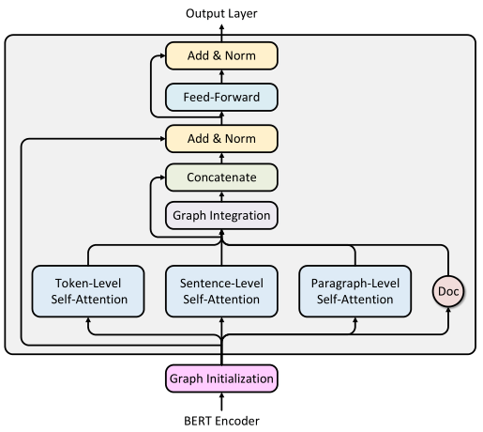







Method
Self-Attention of Graph Encoder
Notes:
hi、hj分别是节点i、j的隐藏表示,即通过bert后的embedding表示
aijk是引入的position embedding是随机进行embedding的，是可学习的，类似于自注意力里的W
自底向上平均分割策略来初始化除token节点之外的节点,长度64为一个sentence节点，长度256为一个paragraph节点，长度为512为一个doc节点

Slide 7
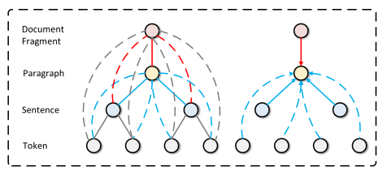
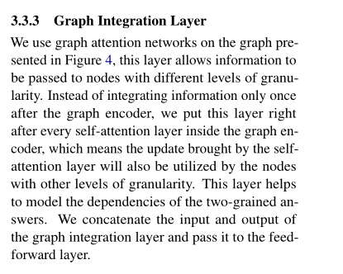
Method
Graph Integration of Graph Encoder

Slide 8
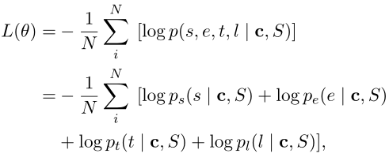

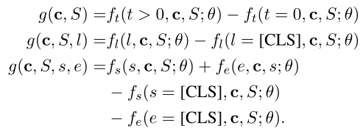
Method
System overview

Slide 9
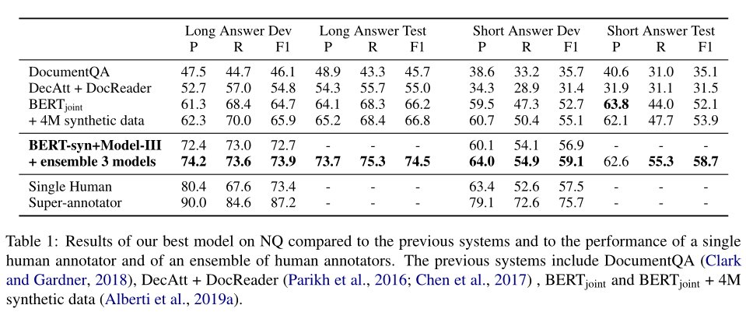
Experiments

Slide 10
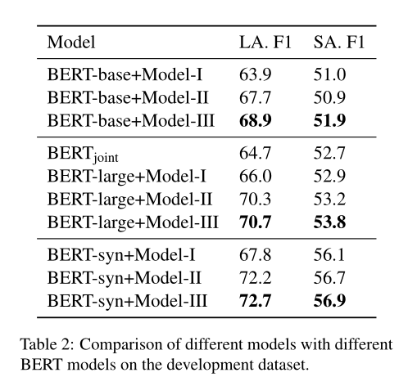
Experiments

Slide 11
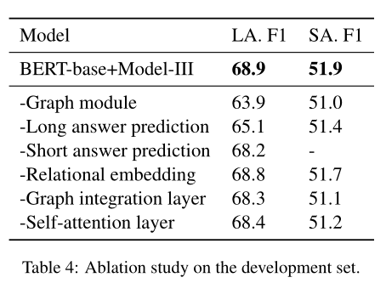
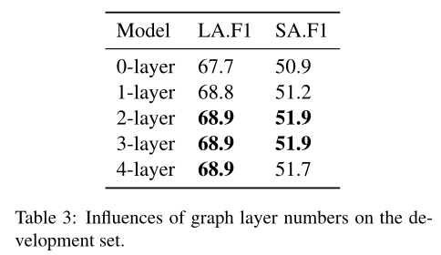
Experiments

Slide 12
Conclusion
In this work, we present a novel multi-grained MRC framework based on graph attention networks and BERT. We model documents at different
levels of granularity to learn the hierarchical nature of the document.
On the Natural Questions dataset, which contains two sub-tasks predicting
a paragraph-level long answer and a token-level short answer, our method jointly trains the two sub-tasks to consider the dependencies of the two-
grained answers.
The experiments show that our proposed methods are effective and outperform the previously existing methods by a large margin.

Slide 13
Thank you!

